Slide 1
W.I.L.D.
Wilderness Information Link Device
MICHAEL SEDLACK - EE & PHYSICS
JUSTIN TUGGLE - EE
Group 10
Brandyn Brinston - CpE
Caleb Phillips - CpE

Slide 2
Project Goal Statement and Description
Our goal was to make a small, portable communication device that does not rely on any external network. The goals of this device were to be suitable for use in adverse conditions with a high level of reliability.
Text-based communication
Battery-powered with solar charging
Long range (>1 mile)

Slide 3
Project Components
Wireless Module
Input/Output
Keyboard
LCD
Cursor
Status Indicators
Enclosure
MCU/Software
Microcontroller
Keyboard input
LCD output
Power Supply and Mainboard

Slide 4
Hardware Block Diagram
I/O
Transceiver
MCU
Display
Keyboard
Status Indicators
Power Supply
Data
Legends:
Brandyn
Caleb
Michael
Justin
Power

Slide 5
Project Components
Wireless Module
Input/Output
Keyboard
LCD
Cursor
Status Indicators
Enclosure
MCU/Software
Microcontroller
Keyboard input
LCD output
Power Supply and Mainboard

Slide 6
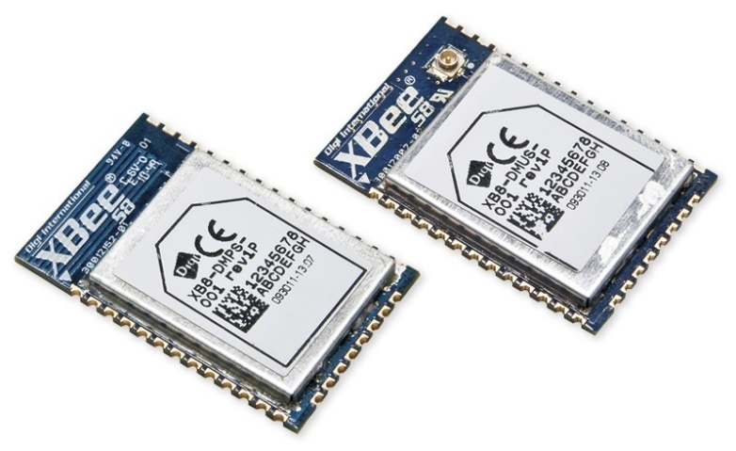
Wireless Communications
XBee (Pro) SX
Maximum range of up to 50 miles
Power usage of 1 watt or less
Cost within project constraints
Capable of peer-to-peer and mesh networks
Built-in data encryption and packet acknowledgment
Conforms to federal power and bandwidth regulations (902-928Mhz, FCC §15.247)
Support for multiple antenna formats (u.fl and RF pad)

Slide 7
Project Components
Wireless Module
Input/Output
Keyboard
LCD
Cursor
Status Indicators
Enclosure
MCU/Software
Microcontroller
Keyboard input
LCD output
Power Supply and Mainboard

Slide 8
Main Input Device Considerations
T9-configuration (predictive text, 9 keys, i.e telephone keypad)
Cursor
QWERTY Keyboard
This type of configuration seemed ideal, as it would give users the easiest means of inputting characters whilst saving time
Considered PCB design or using a pre-made device
Complications for design based off mechanical specs i.e. the dimensions set

Slide 9
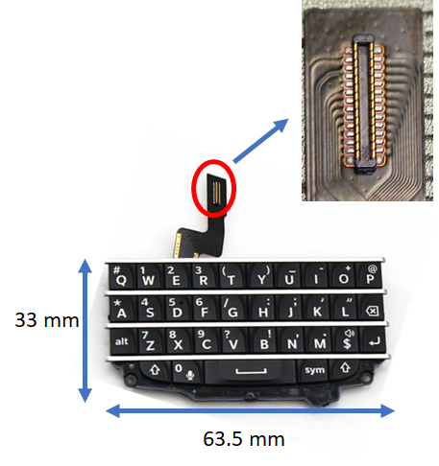
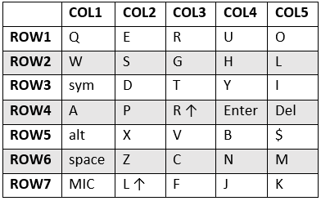
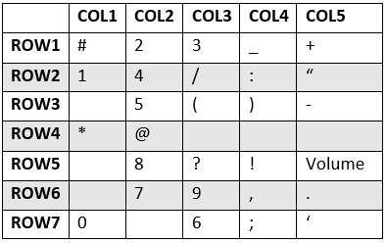
BlackBerry Q10 Module
Operates at 3.3V
Contains backlighting for keys, with a driving current of 40 mA for max brightness
Ergonomically designed for ease and comfort for users when typing
35 regular character inputs, 28 specials
7 Rows x 5 Columns matrix
I2C interfacing

Slide 10
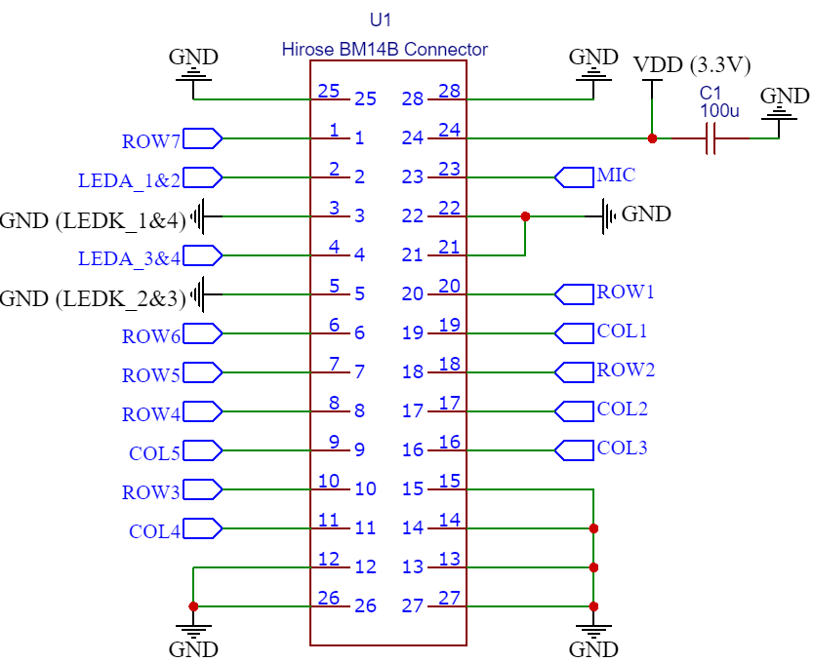
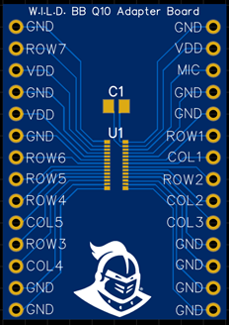
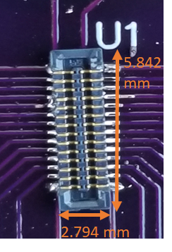


Keyboard Connector (Hirose BM14B)
Rated for 30V, 300 mA
0.4 mm Pitch
28 Conductors
5.842 mm x 2.794 mm x 0.8 mm
Breakout board designed for I/O prototyping

Slide 11
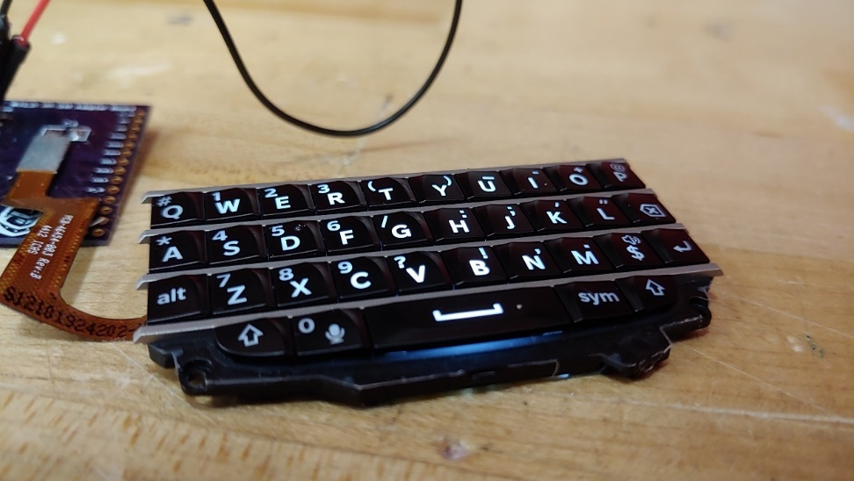
Hardware Testing for Q10
Flex cable properly connects to BM14B
Backlighting for keys successfully turn on once voltage is supplied
Potential displays a change in voltage when a key is pressed

Slide 12
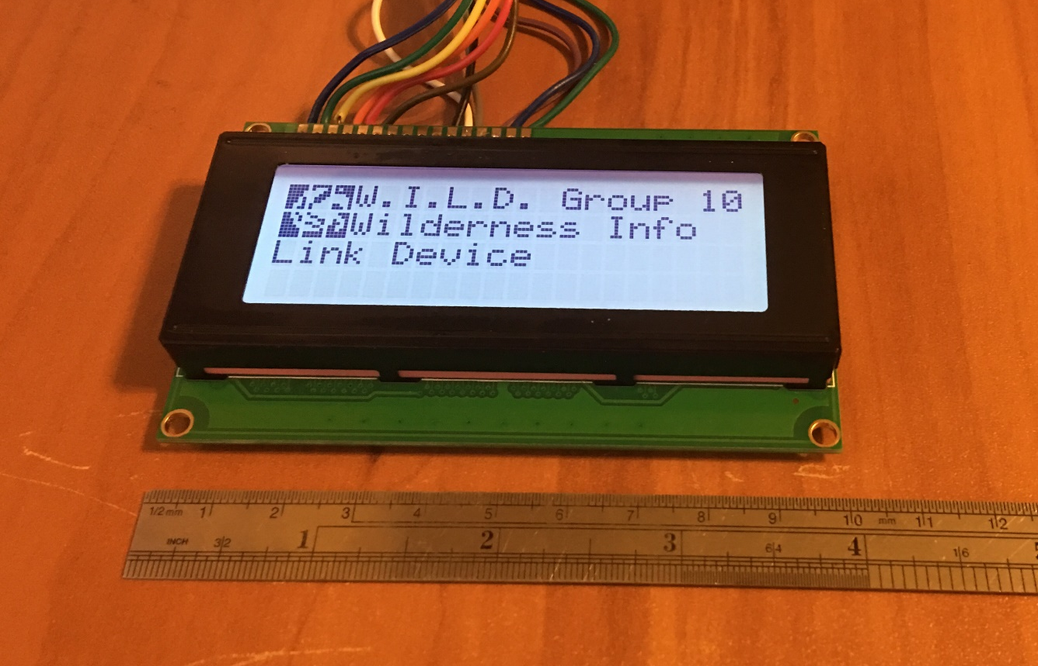
LCD Module (ERM2004-2)
Operates at 3.3V
Backlighting requires 45 mA
20 Char x 4 Line display
16 pin header
8-bit parallel data lines for interfacing, operable in 4-bit mode
Support for custom characters
A menu will be incorporated for the display, containing a variety of option for the user, such as power settings, message pages and device information.

Slide 13
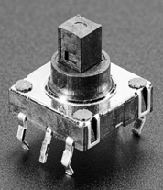
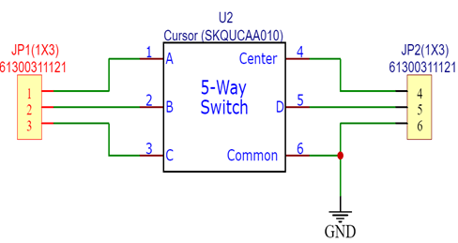
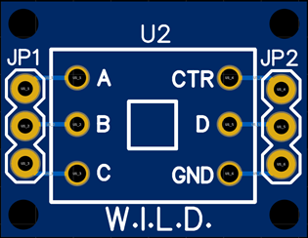
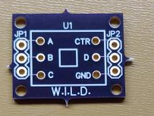
Cursor Input Module (SKQUCAA010)
Practical solution for ease of interfacing and menu navigation
Operates at 1V-12V, 10μA – 50 mA
Five-way directional input (forward, backward, left, right, down)
20.8 mm x 10.67 mm
Another breakout board designed for prototyping purposes

Slide 14
Status Indicators
RGB LEDs will be used as a means of notifying users into the status of messages
Typical 3mm LEDs will be used in a biasing circuit for testing stages of design code
Color coding will be used in conjunction with the various standings/progress of the message
Implementation of MOSFET transistors along with PWM will be necessary in order to make various colors i.e orange, yellow, purple etc.

Slide 15
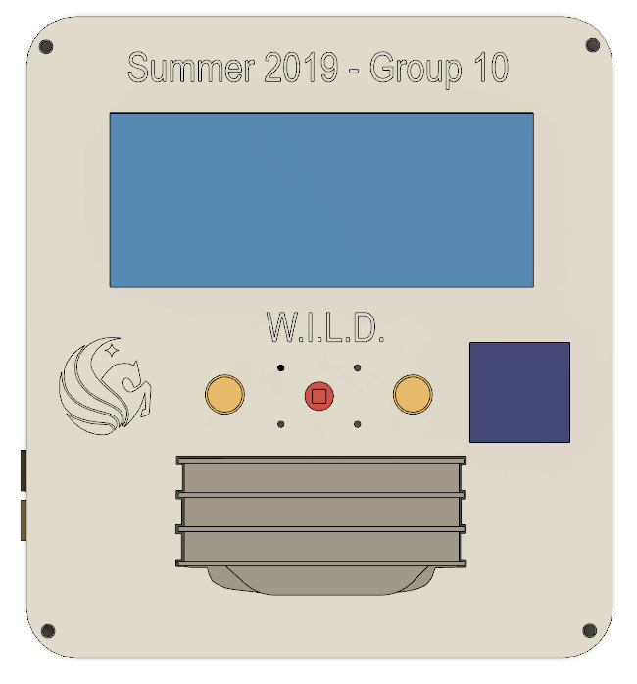
Enclosure
Dimensions are 5.8 in x 5.3 in x 1.635 in
Material is ABS plastic
Mechanical specifications of each component used as basis for cutouts
Designed in Autodesk Fusion 360

Slide 16
Project Components
Wireless Module
Input/Output
Keyboard
LCD
Cursor
Status Indicators
Enclosure
MCU/Software
Microcontroller
Keyboard input
LCD output
Power Supply and Mainboard

Slide 17
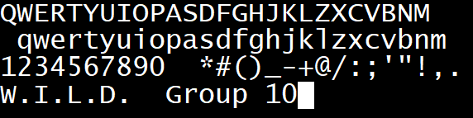
Keyboard Software
• Each column and row corresponds to GPIO pin on MCU
• Row pins set to 1, column pins set to 0
• On key press, row pins read low output
•‘If statements’ used to check pin output
• Once condition met, character or symbol is determined
Keyboard Characters, Symbols, and Numbers

Slide 18
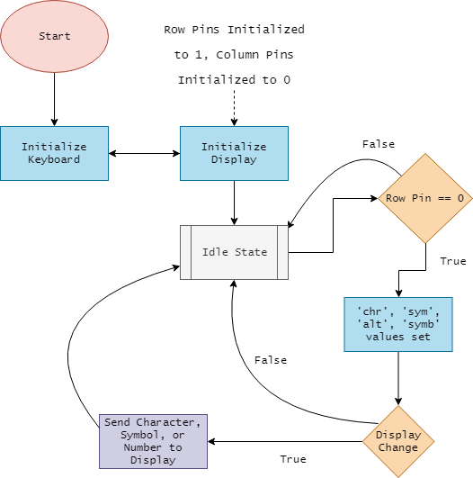
Keyboard Software
Keyboard and Display Software Diagram

Slide 19
MCU Selection
Microcontroller | Architecture | Clock | Storage/RAM | UART | SPI | I2C | ADC Channels | GPIO Pins
ATmega1284P | 8-bit | 20 MHz | 128KB / 16KB | 2 | 3 | 1 | 8 | 32
MSP430FR5964 | 16-bit | 16 MHz | 256KB / 8KB | 4 | 8 | 4 | 20 | 68
MSP432P401R | 32-bit | 48 MHz | 256KB / 64KB | 4 | 8 | 4 | 24 | 84

Slide 20
MCU: MSP432P401R
ARM Architecture
Energy Efficient
Low Power
Low Cost
MCU | Total Power Saving Modes | Active Mode Current Consumption
ATmega1284P | 6 | 320 μA
MSP430FR5964 | 4 | 118 μA
MSP432P401R | 6 | 80 μA
MCU | Cost
ATmega1284P | $ 5.29
MSP430FR5964 | $ 6.45
MSP432P401R | $ 7.46

Slide 21
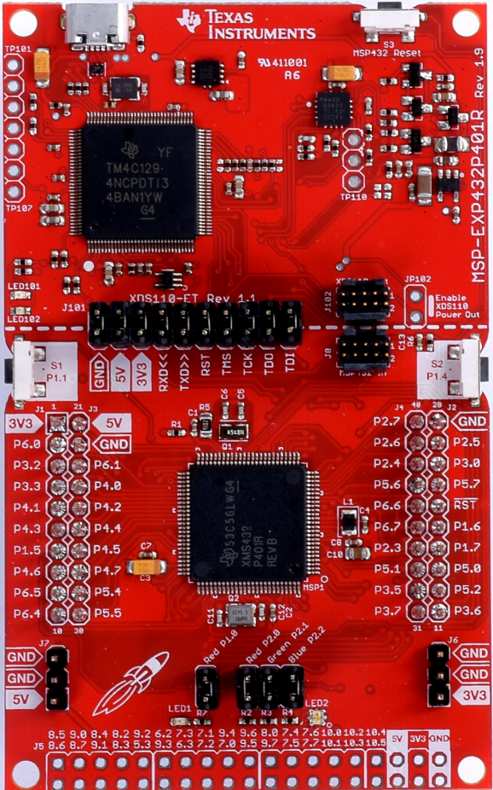
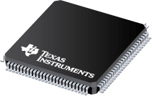
MCU: MSP432P401R
TI Familiarity
Well Documented
Comprehensive Support and Training
MSP432P401R
MSP432P401R Development Board

Slide 22
Project Components
Wireless Module
Input/Output
Keyboard
LCD
Cursor
Status Indicators
Enclosure
MCU/Software
Microcontroller
Keyboard input
LCD output
Power Supply and Mainboard

Slide 23
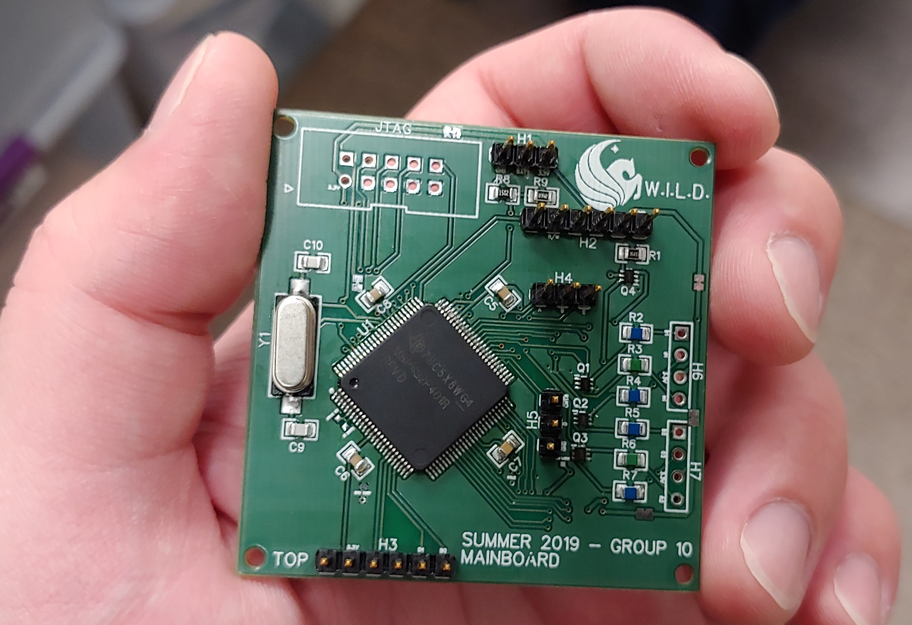
Mainboard Specifications
Provide all necessary support hardware for selected MCU
Provide connections for all device I/O
Compact enough to fit inside reasonably-sized case
Modular as possible to ease in prototyping and assembly
Top of Mainboard

Slide 24
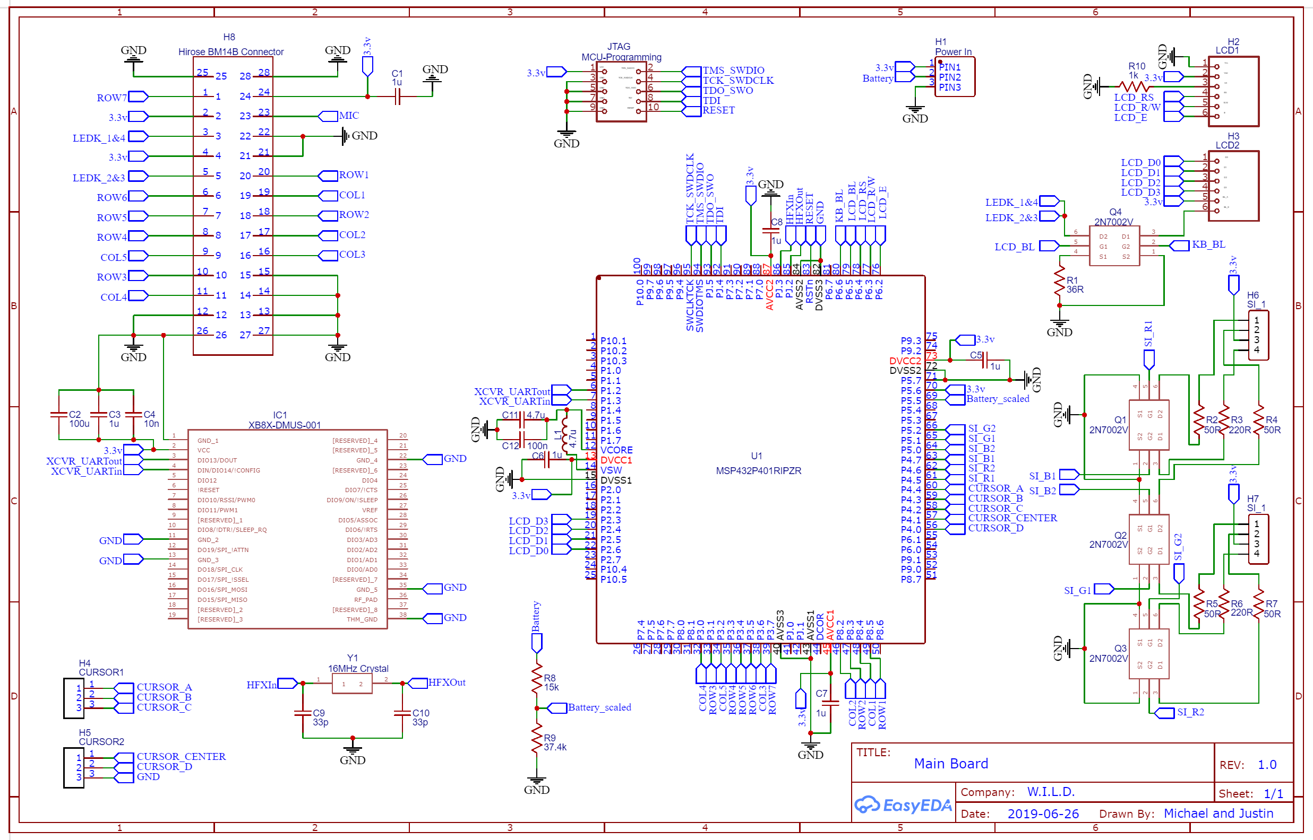
Mainboard Schematic

Slide 25
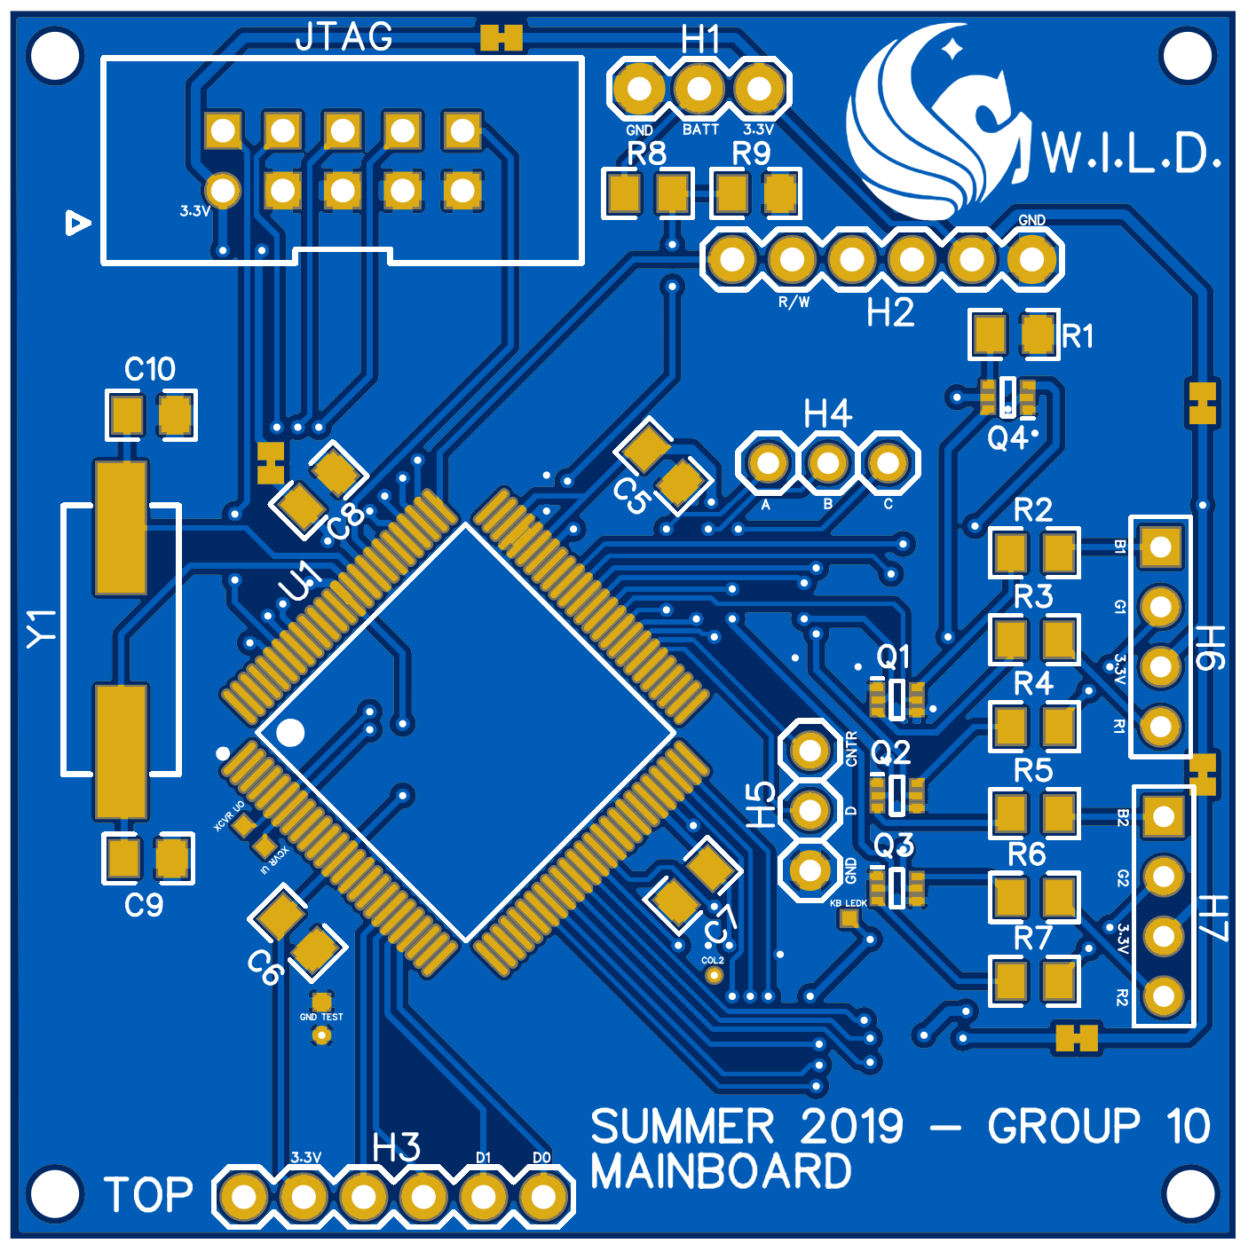
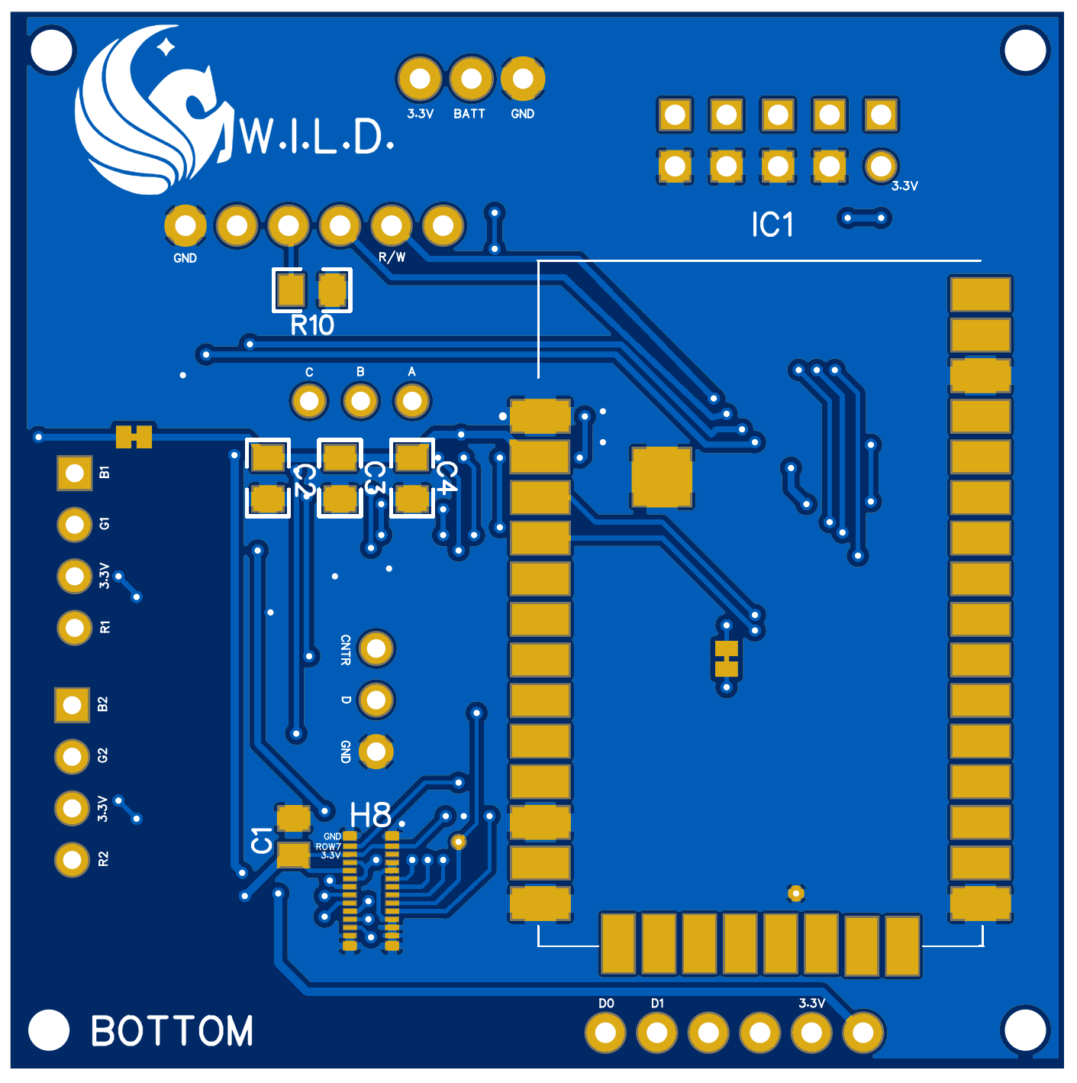
Mainboard PCB
2.04”
Mainboard PCB - Top
2.04”
Mainboard PCB - Bottom

Slide 26
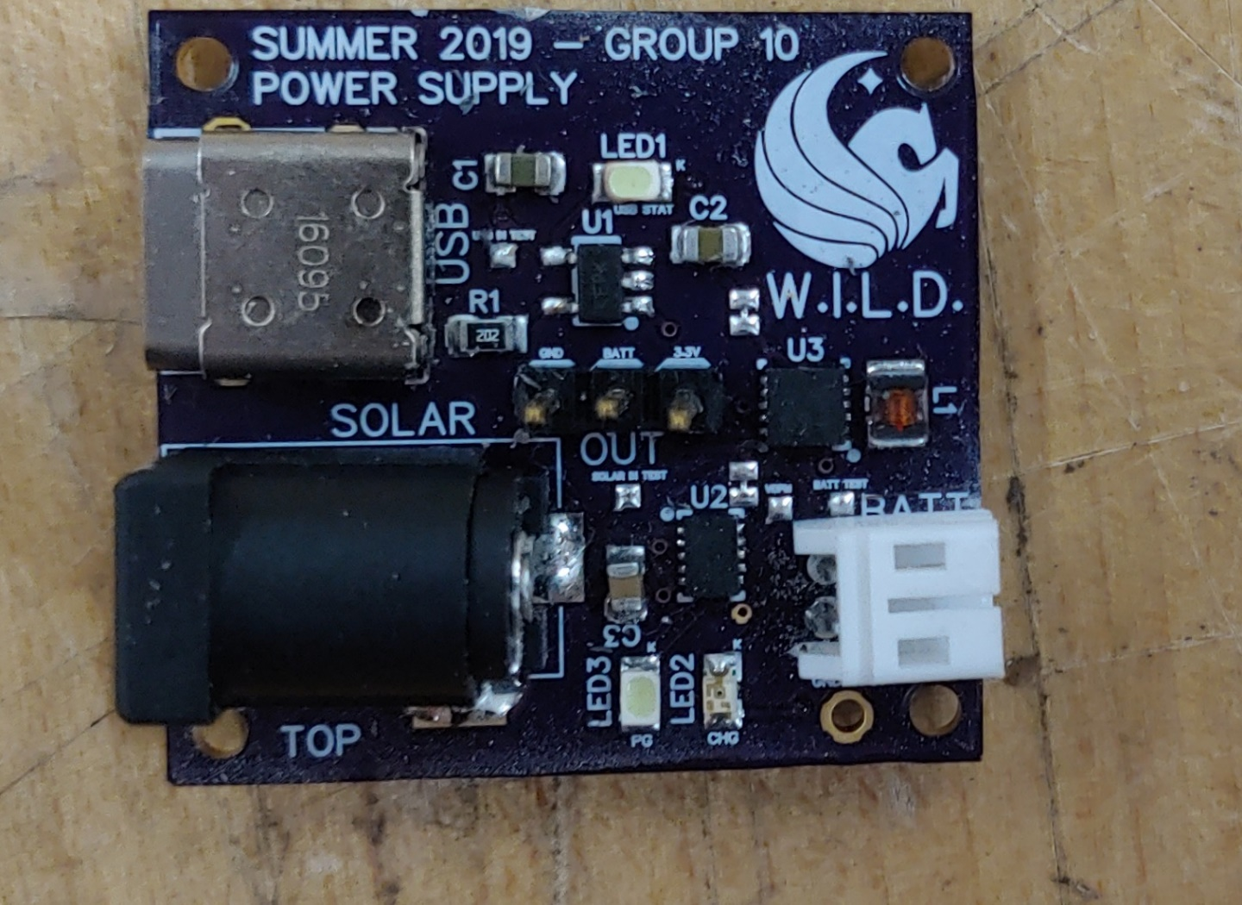
Power Supply Specifications
High efficiency (preferably > 75% from battery to voltage rails)
Single 3.3-volt rail, capable of 1.5A current capacity
Sufficient decoupling to avoid supply sag
Ability to charge 4.2-volt Li-Ion battery from USB and solar
Power Supply Revision 2

Slide 27
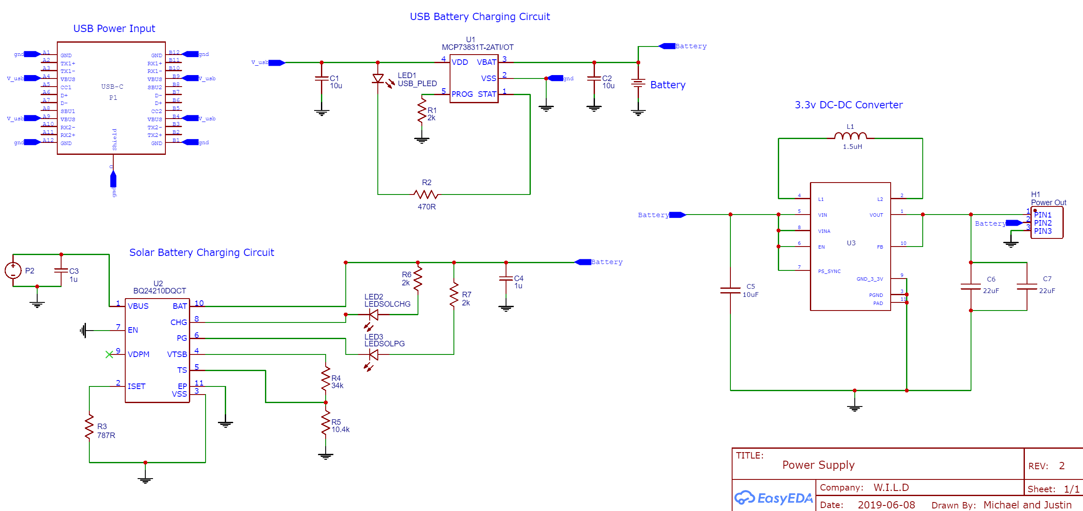
Power Supply Schematic

Slide 28
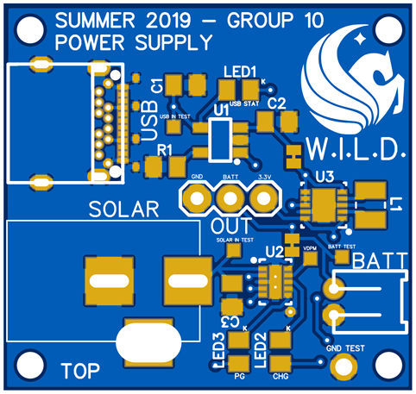
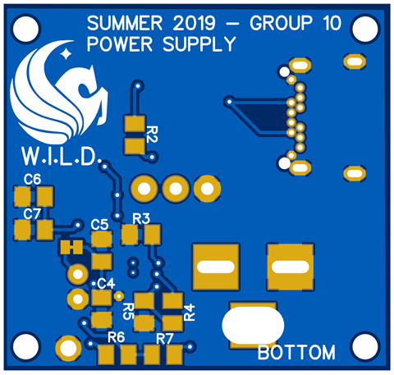
Power Supply PCB
1.160”
Power Supply Revision 2 PCB - Top
1.225”
Power Supply Revision 2 PCB - Bottom

Slide 29
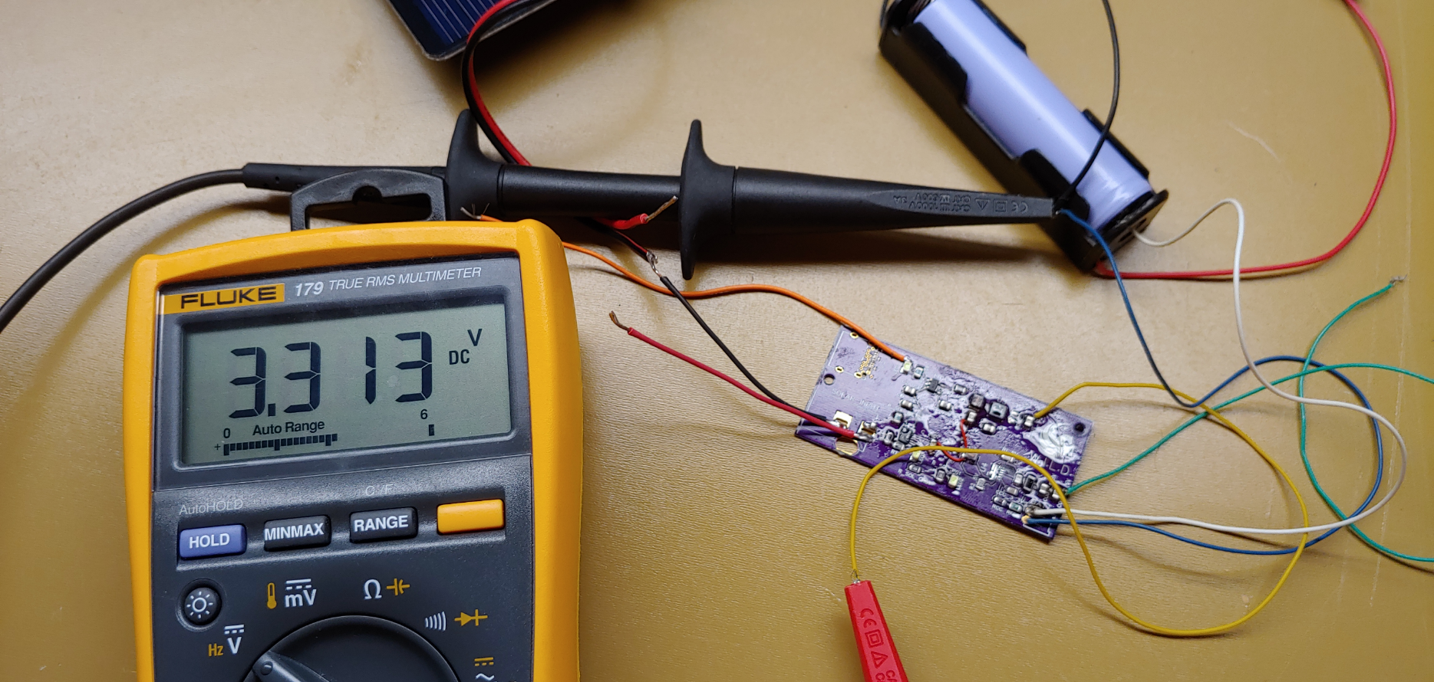
Testing – Power Supply
Confirmed that both USB and solar inputs accept power and attempt to charge the battery
Confirmed that 3.3-volt rail provides a very steady voltage without load
Confirmed that voltage rail remains steady with changing load
3.3-volt rail tested with a battery

Slide 30
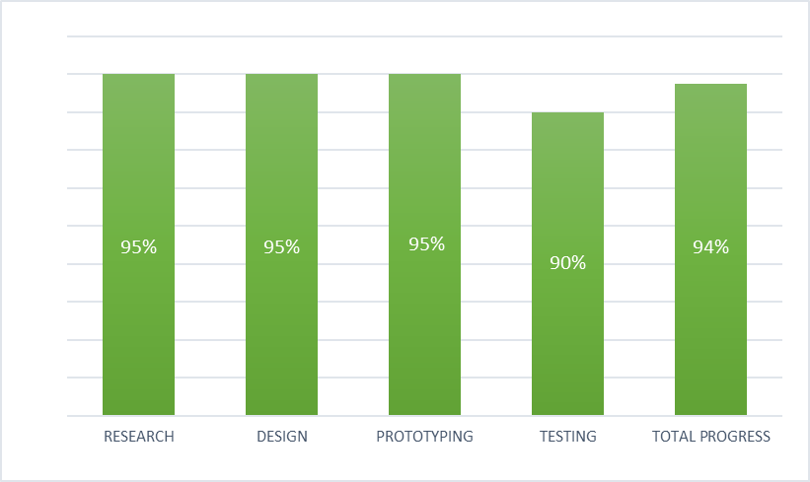
Project Progress

Slide 31
Financing
Item | Quantity | Money Spent
XBee Developer kit | 1 | $249
XBee Chips | 2 | $189
Displays | 3 | $47
Keyboards | 3 | $15
MSP432 Debugging Kit | 1 | $99
Microcontrollers | 3 | $35
PCBs | 2+3 | $140
Board Components & Misc. | NA | $35
Batteries | 3 | $30
Case Printing | 3 | $50
Solar Panels | 3 | $50
Administrative Docs | 2 | $30
 |  | Total: $1070

Slide 32
Team Contributions
Name: | Power | I/O | PCB Design | Keyboard Code | LCD Code | XBee Code | UI Code
Brandyn |  |  |  | Primary | Secondary | Secondary | Primary
Caleb |  | Tertiary |  | Secondary | Primary | Primary | Secondary
Michael | Primary | Secondary | Primary | Tertiary
Justin | Secondary | Primary | Primary

Slide 33
Challenges
Soldering small components on crowded boards
Difficulty working with keyboard connector
Layout of antenna connection on PCB board
Design and fitting of device case
Finding libraries to restrict amount of code stored in MCU—specifically with UI

Slide 34
If we had more time…
Fully functional secondary module
Alternative keyboard option
Direct addressing when sending message
More options to device/more robust UI
More onscreen information; such as displaying current charge

Slide 35
Demonstration

